Slide 1
FACE RECOGNITION SYSTEM USING PRINCIPAL COMPONENT ANALYSIS
AND
EIGEN FACES APPROACH
ANKIT KATIYAR(T19137)
ANURAG MOHAN(T19115)

Slide 2
FACE RECOGNITION SYSTEM USING PRINCIPAL COMPONENT ANALYSIS
AND
EIGEN FACES APPROACH
DATA PREPROSESSING:
                we have 64*64 image . We vectorized it as a row vector of 1*4096.
64*64
1*4096

Slide 3
Similarly,we have 400 images of 40 person with different facial expression,each person having10 images.
400*4096

Slide 4
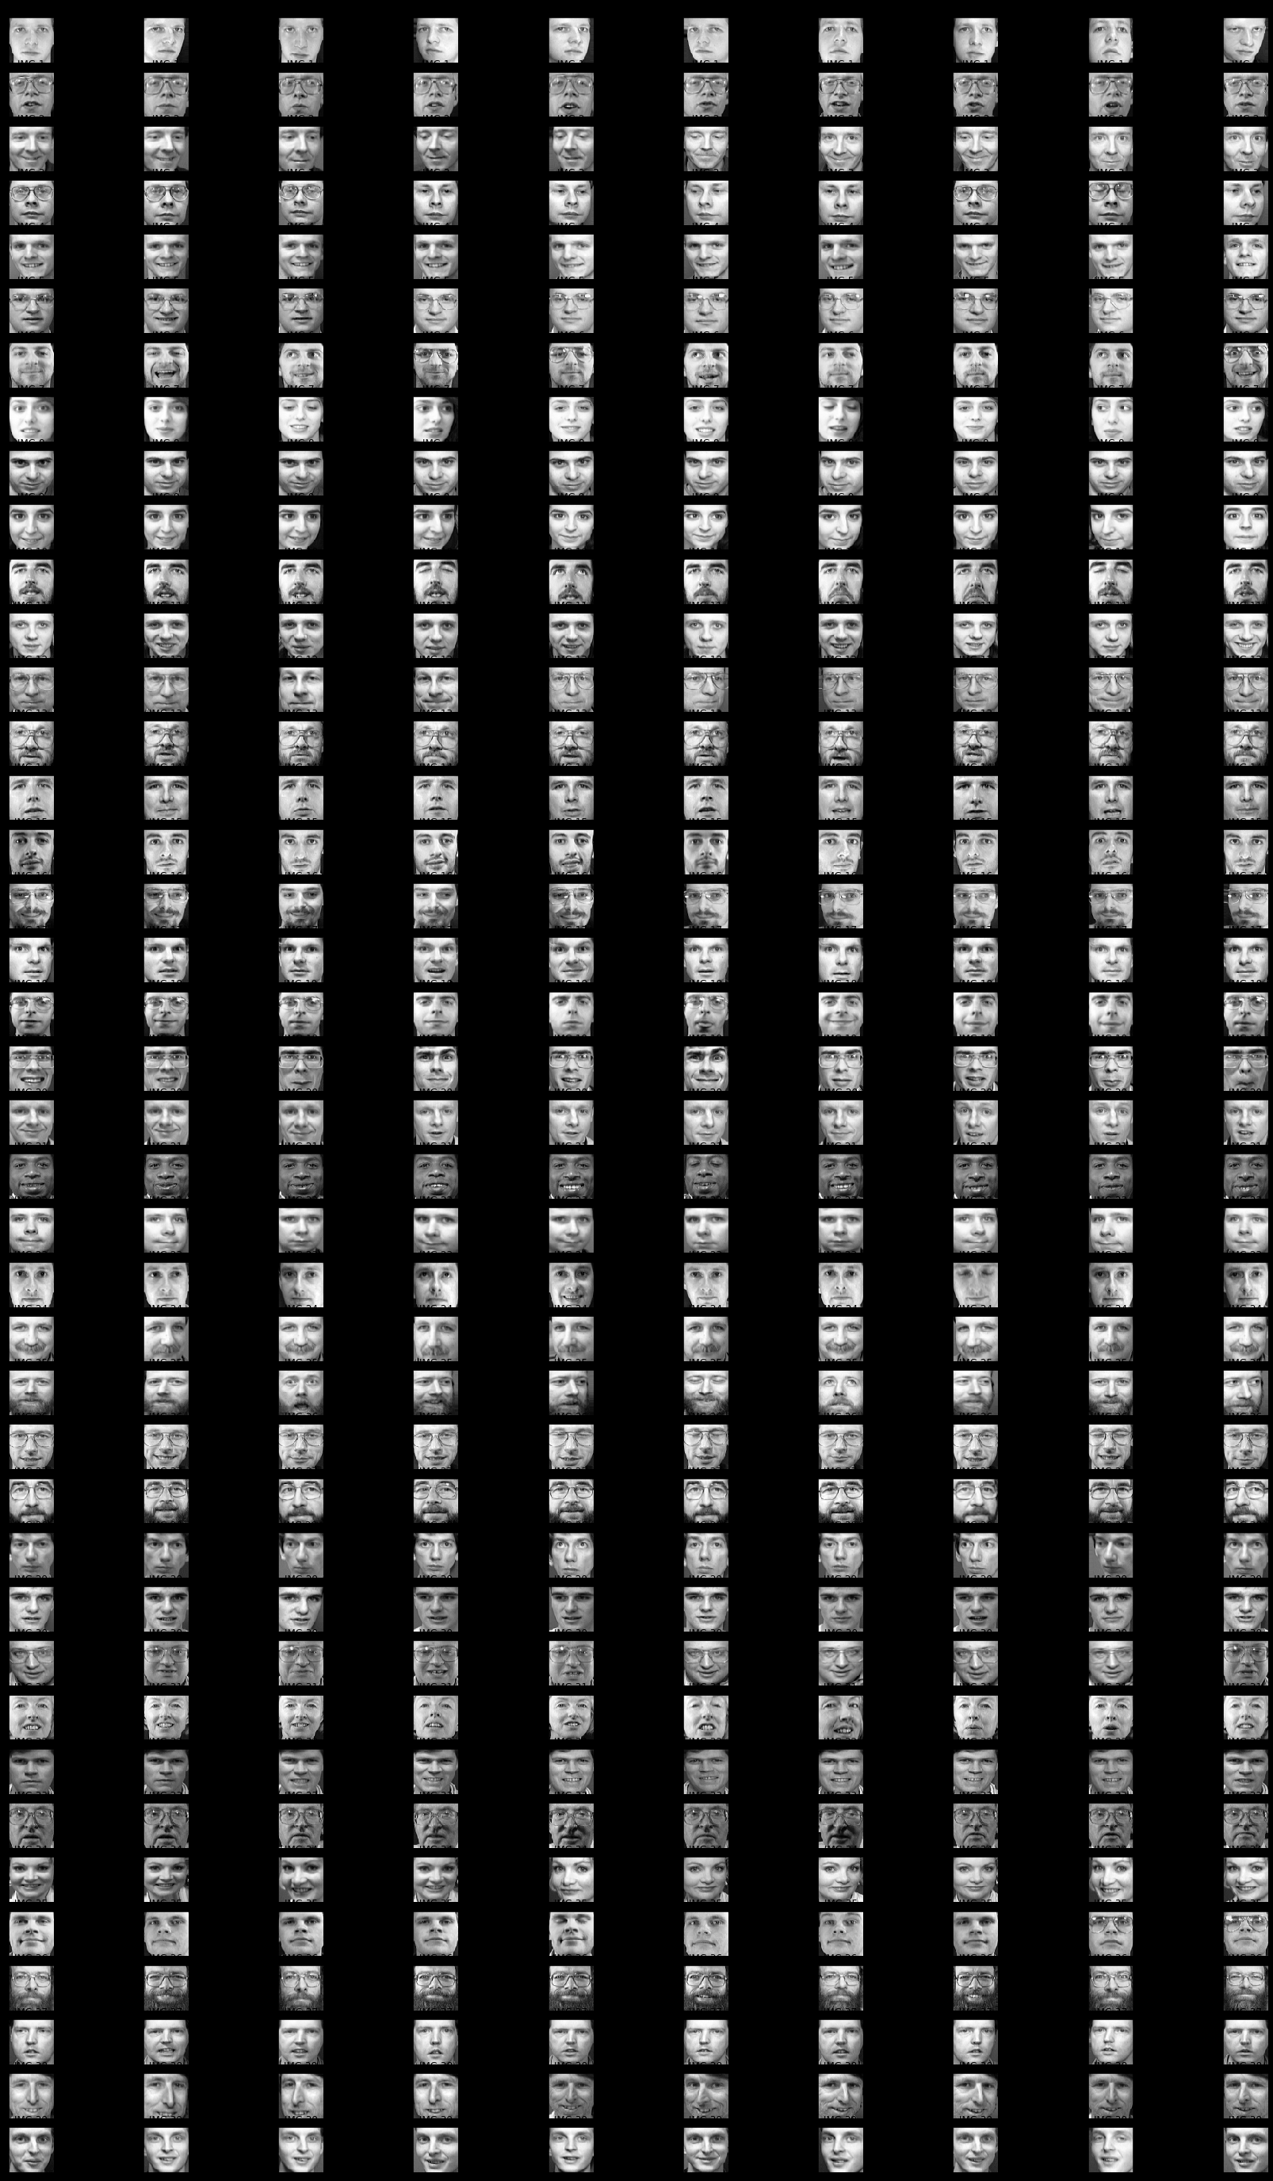

Slide 5
Algorithm
Step1: prepare the training faces Obtain face images I1, I2, I3, I4 , . . . . . . IM (training faces). The face images must be centered and of the same size.
.

Slide 6
Step 2: Prepare the data set Each face image Ii in the database is transformed into a vector and placed into a training set S. In My example M =400. Each image is transformed into a vector of size 1*4096 and placed into the set. For simplicity, the face images are assumed to be of size 64*64 resulting in a point in dimensional space. An ensemble of images, then, maps to a collection of points in this huge space.
Step 3: compute the average face vector The average face vector (Ψ) has to be calculated .
Step 4: Subtract the average face vector :- The average face vector is subtracted from the original faces and the result is stored.

Slide 7
Step 5: Calculate the covariance matrix
Step 6: Calculate the eigenvectors and eigenvalues of the covariance matrix
4096*4096
eigen vector
matrix
Step 7: keep only K eigenvectors (corresponding to the K largest eigenvalues) Eigenfaces with low eigenvalues can be omitted, as they explain only a small part of Characteristic features of the faces.

Slide 8
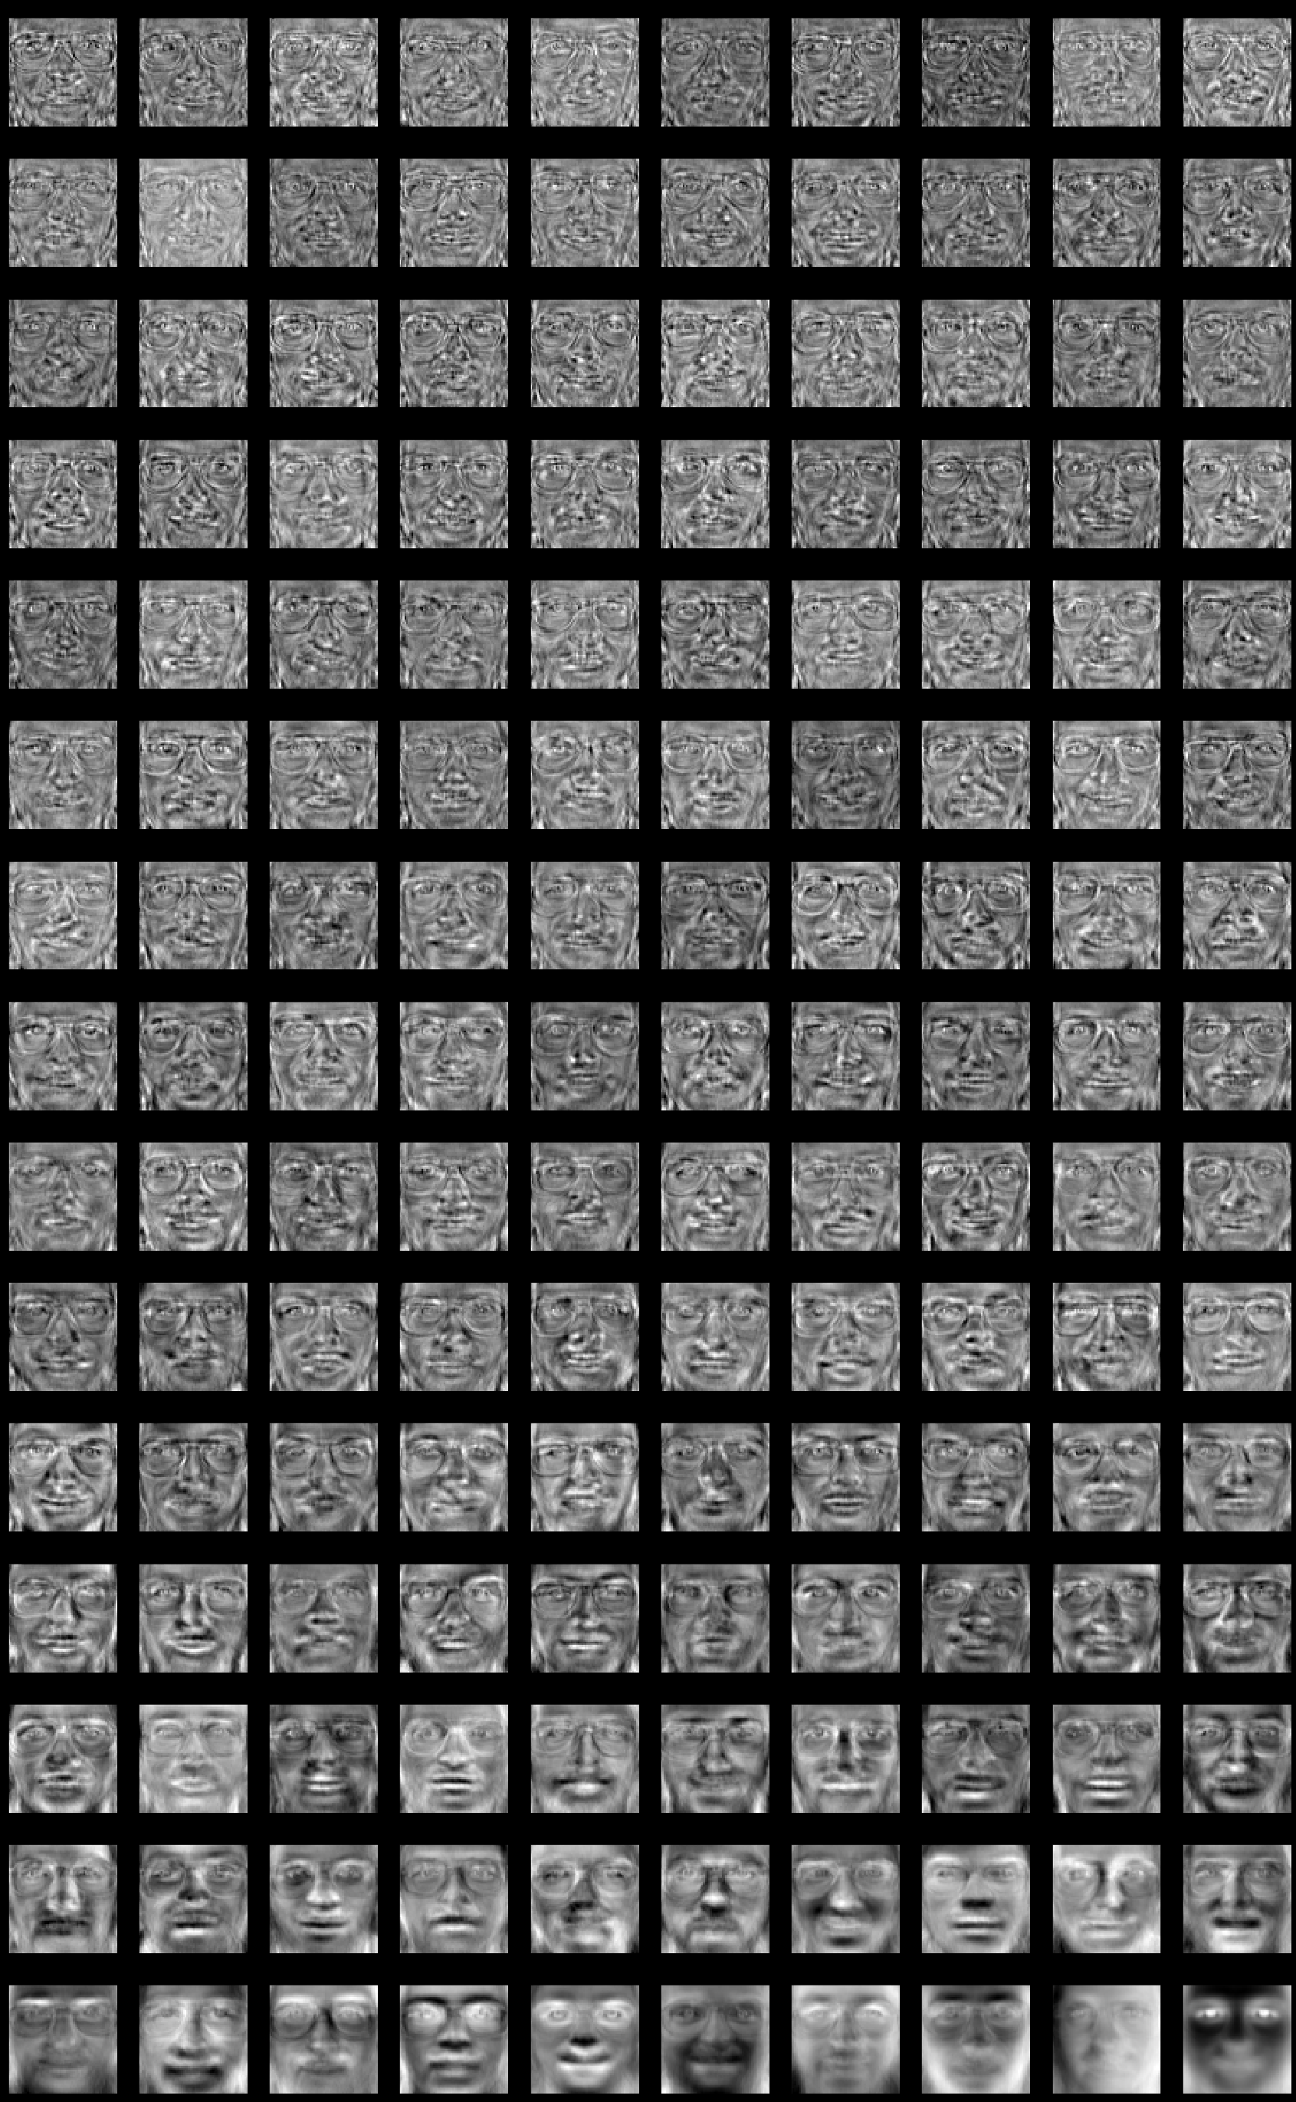

Slide 9
PROJECTION OF TRAINING SAMPLES INTO THE EIGENFACE SPACE
Next we have to project the training sample into the Eigenface space. The feature weight for the training images can be calculated
                Where x=face matrix
                A=eigen vector matrix corres to K maxm eigen val
Y=A^(x-average)

Slide 10
TESTING SAMPLE CLASSIFICATIONS
a) Read the test image and separate face from it.
b) Calculate the feature vector of the test face. The test image is transformed into its eigenface components. First we compare line of our input image with our mean image and multiply their difference with each eigenvector. Each value would represent a weight and would be saved on a vector
c) Compute the average distance (Euclidean distance) between test feature vector and all the training feature vectors. Mathematically, recognition is finding the minimum Euclidean distance , between a testing point and a training point given in the following equation
The Euclidean distance between two weight vectors thus provides a measurement of similarity between the corresponding images.
d) The face class with minimum Euclidian distance shows similarity to test image .

Slide 11
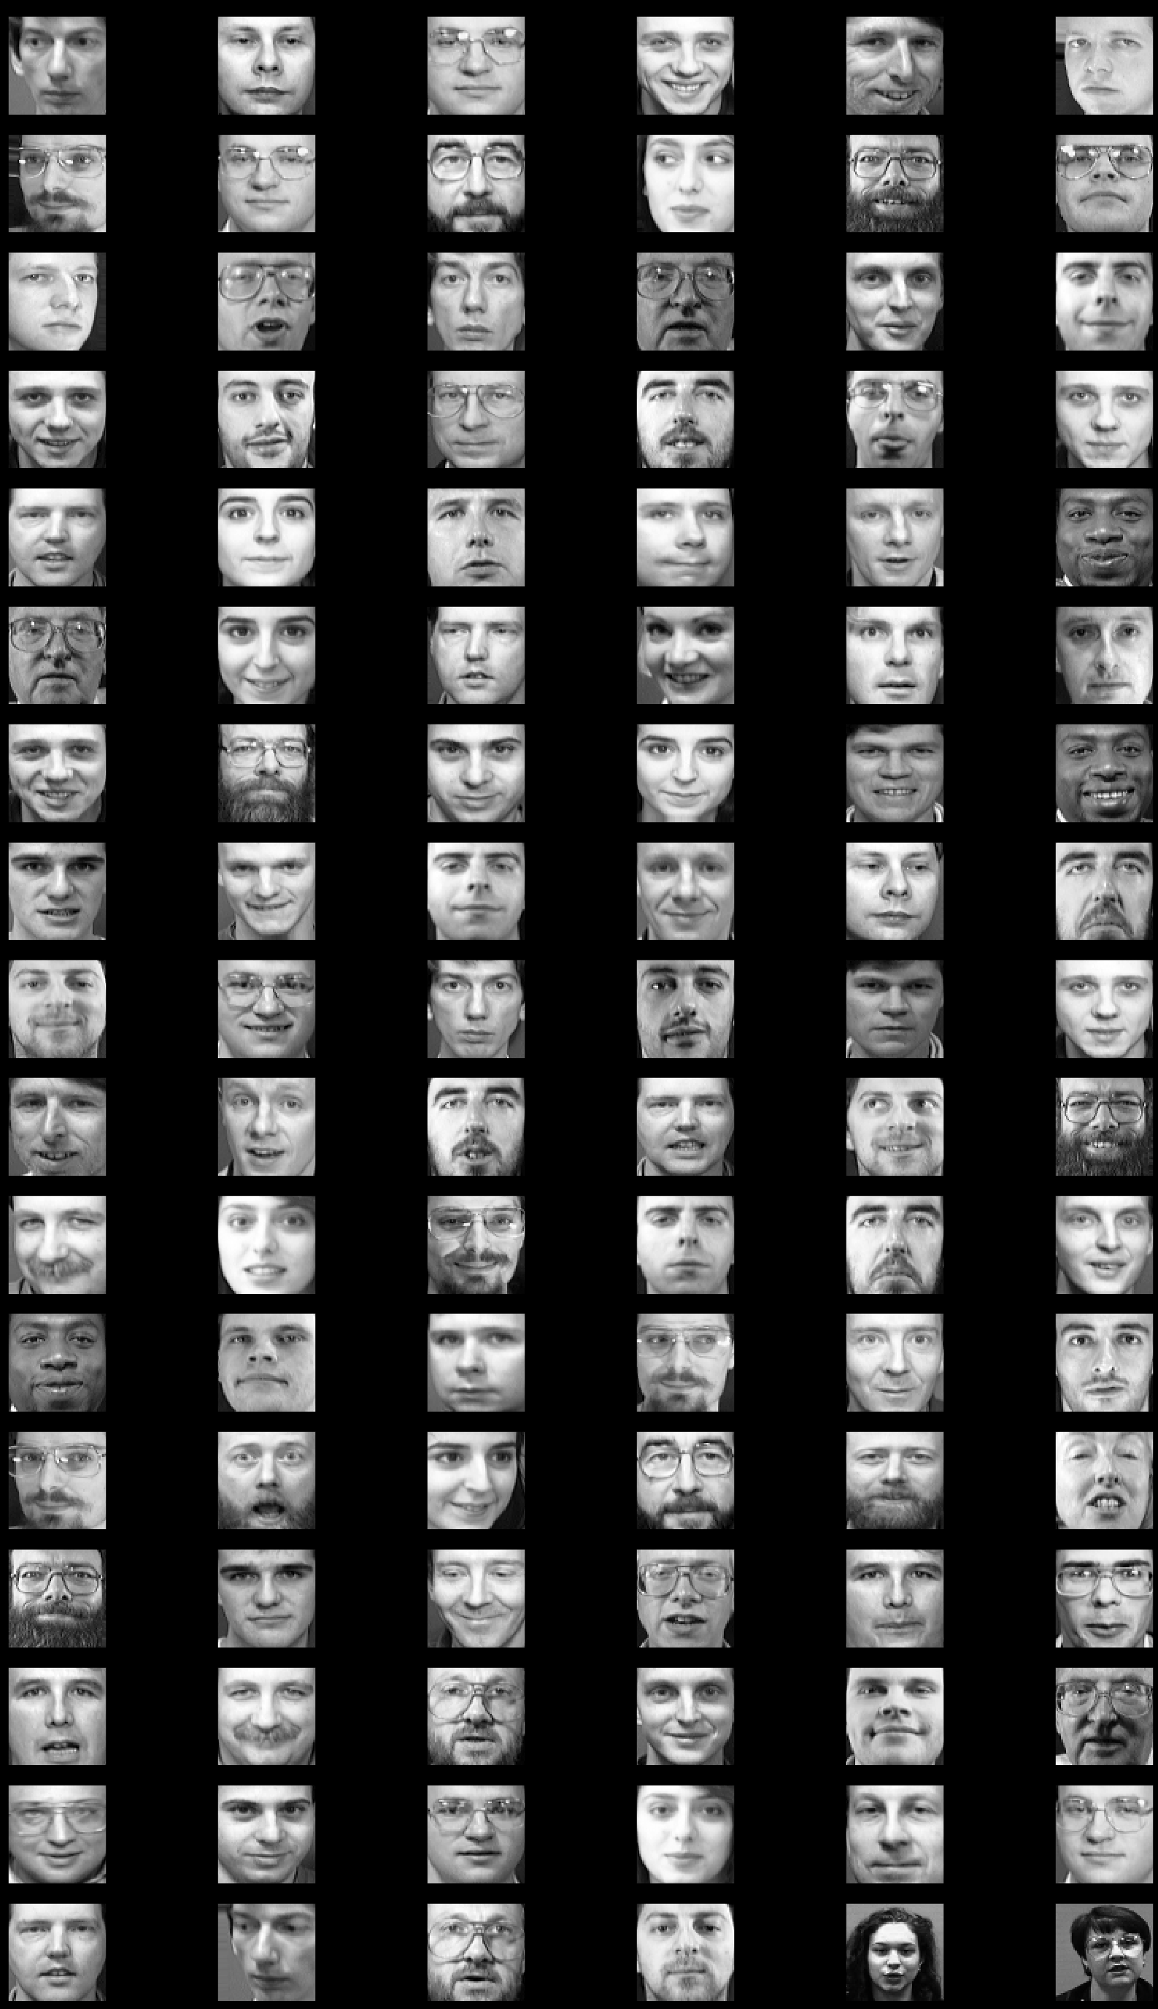
TEST IMAGES

Slide 12
Prediction Result
Predicting people's names on the test set
['IMG28', 'IMG3', 'IMG5', 'IMG11', 'IMG38', 'IMG39', 'IMG16', 'IMG5', 'IMG27', 'IMG39', 'IMG36', 'IMG35', 'IMG0', 'IMG1', 'IMG28', 'IMG33', 'IMG11', 'IMG18', 'IMG11', 'IMG15', 'IMG39', 'IMG10', 'IMG18', 'IMG39', 'IMG37', 'IMG17', 'IMG14', 'IMG22', 'IMG20', 'IMG21', 'IMG33', 'IMG9', 'IMG39', 'IMG20', 'IMG17', 'IMG23', 'IMG11', 'IMG36', 'IMG8', 'IMG9', 'IMG32', 'IMG21', 'IMG29', 'IMG4', 'IMG18', 'IMG20', 'IMG3', 'IMG10', 'IMG6', 'IMG5', 'IMG28', 'IMG15', 'IMG32', 'IMG11', 'IMG38', 'IMG20', 'IMG10', 'IMG37', 'IMG6', 'IMG36', 'IMG39', 'IMG7', 'IMG16', 'IMG18', 'IMG10', 'IMG39', 'IMG21', 'IMG35', 'IMG22', 'IMG16', 'IMG9', 'IMG15', 'IMG16', 'IMG25', 'IMG9', 'IMG27', 'IMG25', 'IMG31', 'IMG36', 'IMG29', 'IMG39', 'IMG1', 'IMG14', 'IMG39', 'IMG14', 'IMG24', 'IMG13', 'IMG11', 'IMG35', 'IMG33', 'IMG20', 'IMG8', 'IMG5', 'IMG7', 'IMG12', 'IMG5', 'IMG37', 'IMG28', 'IMG13', 'IMG6', 'not matched', 'not matched']

Slide 13
Conclusion
In this project we have implemented face recognition system using principal componenet analysis and eigen faces approach.The system successfully recognises the faces and worked better in different condition of face orientation.

Slide 14
THANKS

